Slide 1
DORMITORY MANAGEMENT SYSTEM
PREPARED BY:
20700051 – Ghalyah Eldandashi
20801513 – Rakhimjon Berdiev
20802777 – Seyedehmahissa Salehnezhad
20803145 – Nazir Alatar
20911068 – Sulaimon Inomov

Slide 2
TABLE OF CONTENTS
01
02
03
04
05
INTRODUCTION
KEY FEATURES
ENHANCED FUNCTIONALITIES
ADDITIONAL FEATURES
SUMMARY

Slide 3
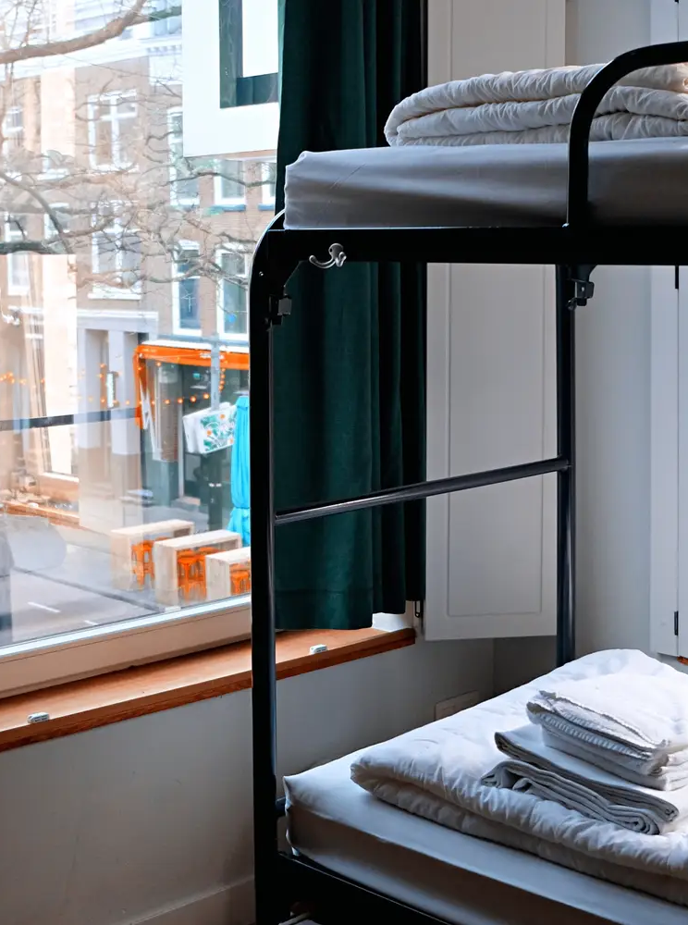
Welcome to the Future of Living in Dorms
Creating Better Places for Students
A Fresh Start for Living on Campus
Easy and Smart Living with Just a Click

Slide 4
KEY FEATURES
USER FRIENDLY INTERFACE
Easy Registration and Login:
Students can create accounts quickly
Secure Authentication ensures data privacy
DORMITORY SEARCH
Advanced Search Options:
Filter Dormitories by location, price range, and other preferences
Organized and user-friendly search results
Real-time price information:
Access current dormitory prices
View historical price trends to make informed decisions

Slide 5
ENHANCED FUNCTIONALITIES
Service Comparison
Detailed Information:
Comprehensive details about dormitory services and amenities
Side-by-Side Comparison:
Compare multiple dormitories to find the best fit
Rating and Feedback
Public Rating System:
Students can rate dormitories they have stayed in
Student Reviews:
Written feedback helps others make informed decisions

Slide 6
ADDITIONAL FEATURES
Owner Interface
Manage Listings:
Dormitory owners can easily register and log in.
Update dormitory details, pricing, and availability.
Booking System
Real-Time Booking:
Students can reserve dormitory rooms in advance.
Payment Processing:
Secure and efficient payment options.
Confirmation emails sent upon booking.

Slide 7
SUMMARY

Slide 8

THANK YOU !

